Slide 1

Unit 2
Contrast Stretching or Piecewise Linear Transformations

Slide 2
Contrast Stretching
Used to enhance low-contrast image
Low-contrast images occur due to:
Poor illumination
Lack of dynamic range in the imaging sensor
Wrong setting of lens aperture
Expands the intensity level in an image
So that it spans the full intensity range of the recording medium or the display device

Slide 3
Transformation for contrast stretching
Location of (r1, s1) and (r2, s2) controls the shape of the transformation function
If r1= s1 and r2=s2 then it is a linear function
There is no change in the intensity of the enhanced image, it will be the same as the original image
If r1=r2 and s1=0 and s2=L-1 then it is a thresholding function, you get a binary image
Intermediate values of r1 and r2 produces various intensity values.
This changes the contrast in the image

Slide 4
In general, r1<=r2 and s1<=s2 is assumed.
(r1,s1)= (rmin, 0) where rmin is the minimum intensity value
(r2,s2) =(rmax,L-1) where rmax = maximum intensity value
Transformation function stretches the intensity values of the original image to the full range of 0 to L-1.
Contrast stretching is only possible if the minimum intensity value and maximum intensity values are not equal to the possible min and max value
rmin<>0
Rmax<>255

Slide 6
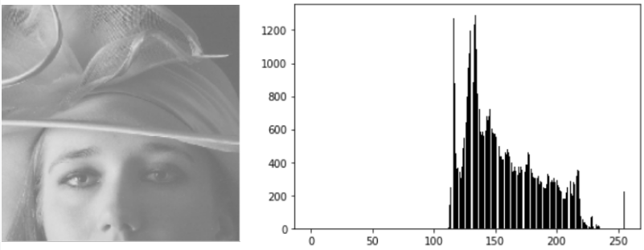
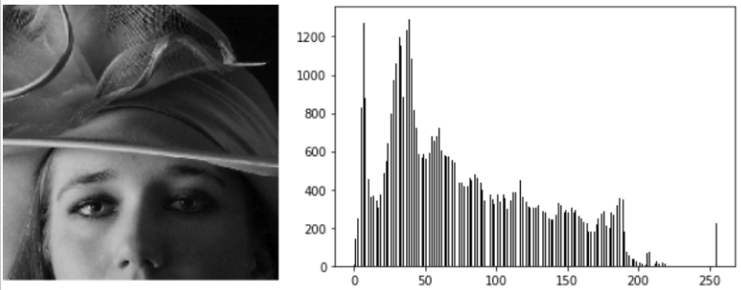
For an 8 bit image with intensity values between 0 and 255
S= 255*(r-rmin)/(rmax-rmin)
Image with intensity values ranging from 100 to 220 will be stretched to 0 to 255

Slide 7
Intensity level slicing
Highlights a specific range of intensities in an image
Enhance some features of the image(e.g water body in a satellite image)
Display all intensity values of interest in one value(say 1) and the rest of the values in another value(say 0)
It produces a binary image
Highlights intensity values between
A and B and reduce all the other values
to a minimum

Slide 8
Brighten or darken the intensity values of interest and the leave the rest of the values at the original value.
Values between A and B is highlighted
remaining are at the original values

Slide 10
Bit Plane Slicing
Pixel values are composed of bits
256 = 2^8
Highlight the contribution made by specific bits to the image appearance
256: 8 bit planes (1111 1111)
Plane 1: lowest order bit
Plane 8: highest order bit
4 bit image : 0 to 15
10: 1010
5: 0101
8: 1000
3: 0011

Slide 11
Bit plane slicing
10 | 5 | 8 | 3
2 | 4 | 7 | 5
1010 | 0101 | 1000 | 0011
0010 | 0100 | 0111 | 0101
Four higher-order bit planes have the
most significant visual information
Lower-order bit planes contribute to
more subtle intensity details
1 | 0 | 1 | 0
0 | 0 | 0 | 0
0 | 1 | 0 | 0
0 | 1 | 1 | 1
1 | 0 | 0 | 1
1 | 0 | 1 | 0
0 | 1 | 0 | 1
0 | 0 | 1 | 1

Slide 13
Reconstructing the image from bit planes
1010 | 0101 | 1000 | 0011
0010 | 0100 | 0111 | 0101
1000 | 0100 | 1000 | 0000
0000 | 0100 | 0100 | 0100
10 | 5 | 8 | 3
2 | 4 | 7 | 5
8 | 4 | 8 | 0
0 | 4 | 4 | 4

Slide 14
With 8,7,6,5
With 8 and 7
With 8,7,6,5,4,3

Slide 15
Decomposing an image into bit planes is useful to identify the relative importance of each bit in the image
Useful for image compression

